Slide 1

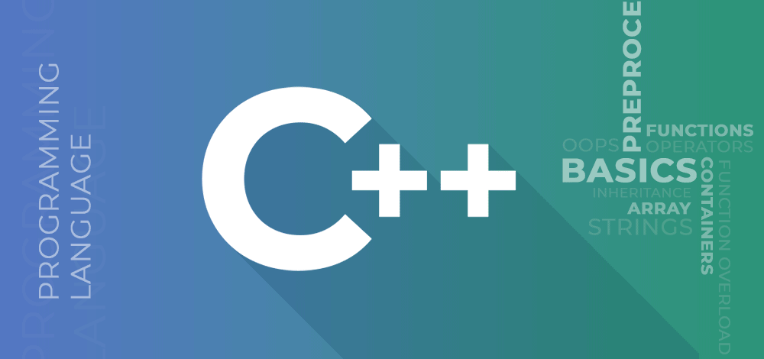





Master C++ Programming
With Examples
01
By Ramjilal Meena
Complete C++ Programming

Slide 2
Master C++ Programming
With Examples
01
By Ramjilal Meena
Overview & Basics of C++
Variables and Constants in C++
Storage Classes in C++
Data Types and Literals in C++
Operators in C++
Input/Output in C++
Control Statements in C++
Functions in C++
Pointers and References in C++
Arrays & Strings in C++
Structures and Union in C++
Memory Management in C++
Preprocessors in C++
Namespace in C++
Complete Basic C++ Programming

Slide 3
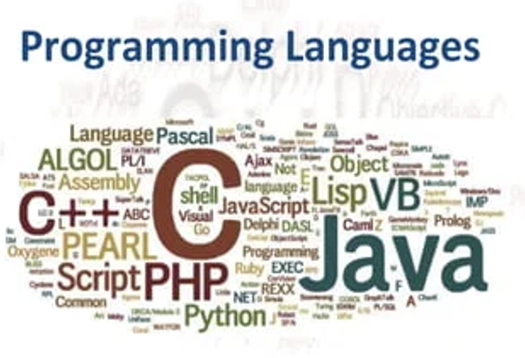
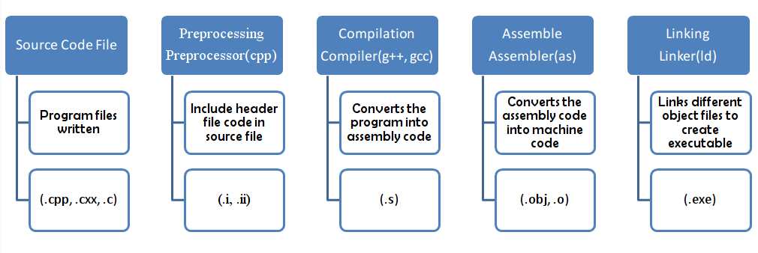
Program & Programming Language
02
By Ramjilal Meena

Slide 4
Program & Programming Language
Program : A sequence or set of instructions in a programming language for a computer to execute.
Programming languages : a set of instructions written in a specific language to perform a specific task.
(mainly used to develop desktop applications, operating systems, websites, mobile applications, etc.)
Why do we need? : Need a specific language to communicate with human or computer.
Types of programming languages
Low-level language - Close to hardware
High-level language - Close to Humans
Middle-level language - Intermediate

Slide 5
Programming Language
Low-level language
Machine-dependent.
Based on the binary number 0’s and 1’s.
Processor runs low-level programs directly. (No need of a compiler or interpreter)
Very fast.
Not portable.
Machine Language
Does not require a translator to convert the programs because computers directly understand the machine language programs
Also called machine code or object code.
Difficult to read and write.
Assembly Language
Assembly language is designed for specific processors.
It represents the set of instructions in a symbolic and human-understandable form.
It uses an assembler to convert the assembly language to machine language.
A high-level language
user-friendly.
Requires a compiler or interpreter to translate the program into machine language (execute the program).
Example: Python, Java, JavaScript, PHP, C#, C++, etc.
Procedural Oriented programming language → ( C, FORTRAN, Basic, Pascal )
Derived from structured programming & based upon the procedure call concept.
It divides a program into small procedures called routines or functions.
Object-Oriented Programming language → (C++, Java, Python, C#)
Based upon the objects & classes.
used to implement real-world entities like inheritance, polymorphism, abstraction to make the program reusable, efficient, and easy to use.
Natural language
Natural language is a part of human languages
e.g. English, Russian, German, and Japanese.
Middle-level language
MLL lies between the low-level & high-level programming language.
known as the intermediate programming language and pseudo-language.
Advantages
Supports the features of high-level programming
User-friendly language
Closely related to machine language and human language.
Example: C, C++

Slide 6

Thank You
Please
Like
Subscribe
Comment

Slide 7
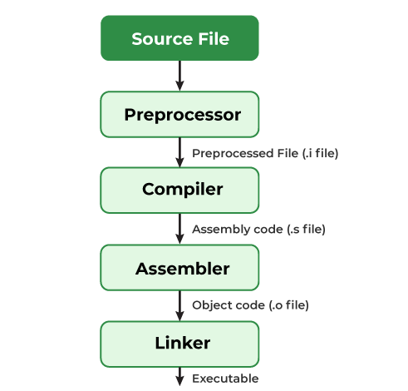
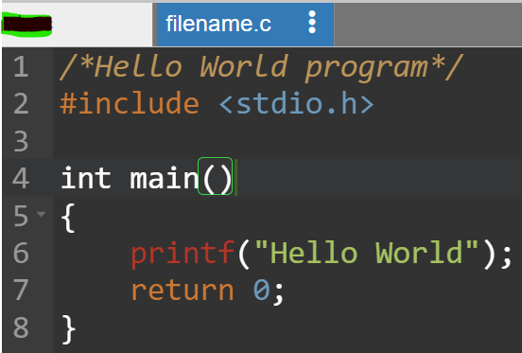
Compiling a Program |Behind the Scenes
03
By Ramjilal Meena

Slide 8
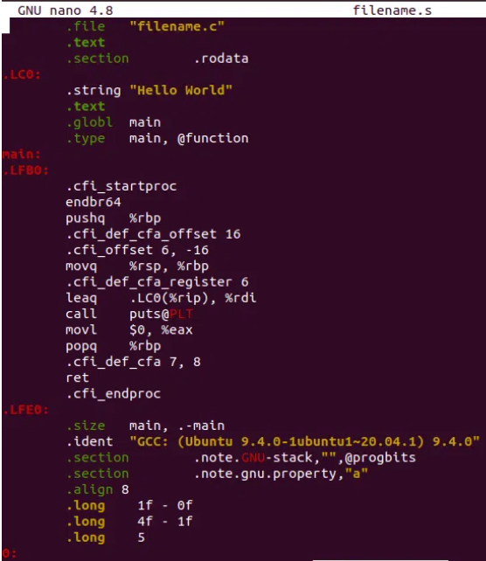
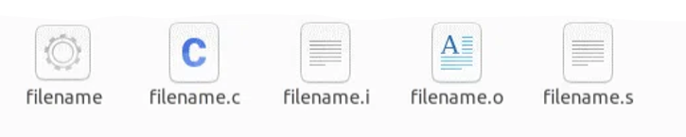
The compilation process
Need a compiler and a code editor to compile and run a C Program
Process of converting source code into machine code.
Source File –> filename.c
Pre-processing –> filename.i
Removal of Comments.
Expansion of Macros.
Expansion of the included files.
Conditional compilation.
Compiling –> filename.s
produce an intermediate compiled output.
output file is in assembly-level instructions.
Assembling –> filename.o
This file contains machine-level instructions.
Existing code is converted into machine code.
The function calls like printf() are not resolved.
Linking –> filename.exe / filename
Linking of function calls with their definitions.
Linker adds some extra code, required when the program starts and ends.

Slide 9
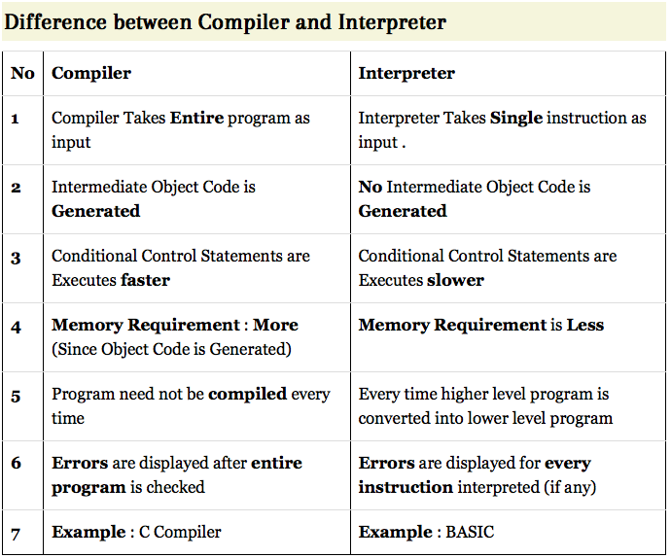
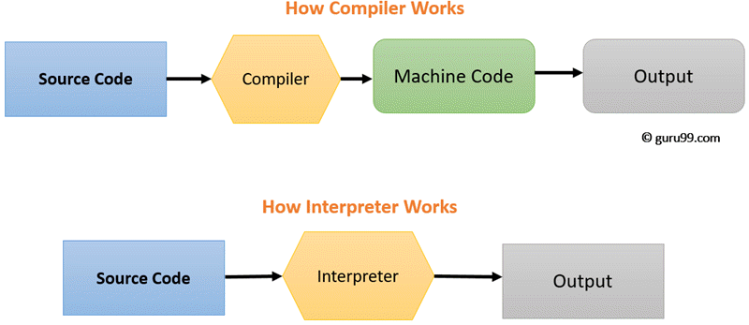
Compiler Vs Interpreter
Interpreters & Compilers convert the Source Code (HLL) to Machine Code (understandable by Computer)

Slide 10
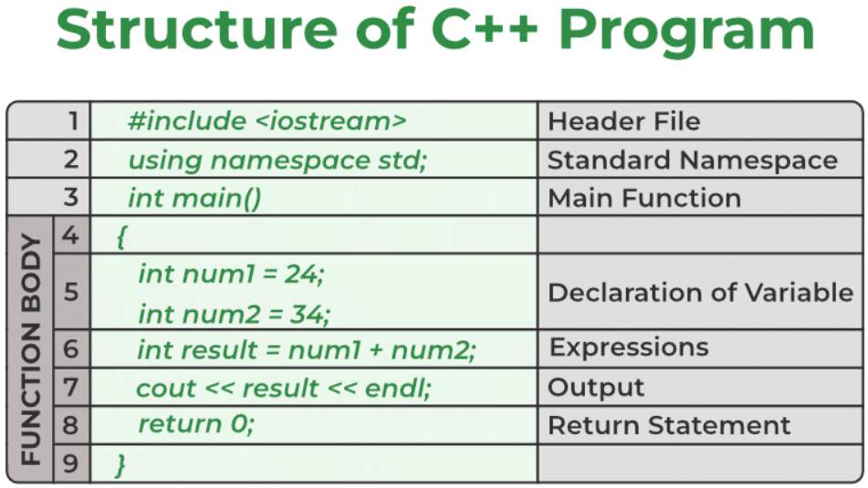

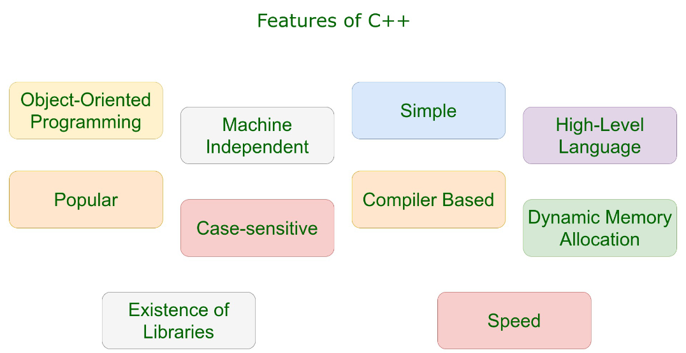
Overview & Features |First C++ Program
04
By Ramjilal Meena

Slide 11
Overview & Features
What is C++?
A most popular cross-platform programming language, Used to create high-performance applications and software like OS, Games, E-commerce software, etc. developed by Bjarne Stroustrup, as an extension of C language.
Why Learn C++?
Features
Most used & Most popular
Cross-platform programming language.
High-level and object-oriented programming language.
Allows developers to write clean and efficient code for large applications, software, games, and operating systems.
supports procedural, functional, and generic programming styles.
Expansion of the C programming language to include Object Oriented Programming(OOPs).
Give a high level of control over system resources and memory.
Features
Simple – easy to read & write
a general-purpose programming language
support low-level, system-level programming
Machine Independent but Platform Dependent
Speed of execution - Compiled Language
Rich library support – STL, BOOST etc.
Pointer and direct Memory-Access
Exception Handling
Mid-level language
Templates

Slide 12
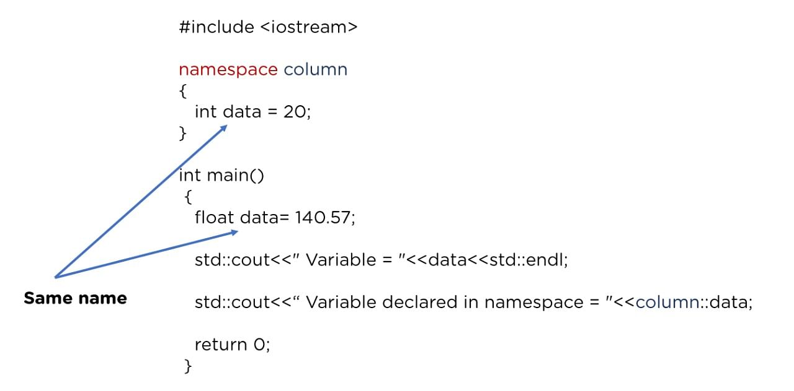
First C++ Program
Parts of C++ Program
Comments
Preprocessor directive
Namespace
Main function
return 0
Comments
To make a code more readable, understandable by providing more descriptions.
Can be used to prevent the execution of some parts of the code.
A person reading a large code will be bemused if comments are not provided about details of the program.
Types of comments in C
// Single-line comment
/* Multi-line comment */
Preprocessor directive
Tell the compiler to preprocess the source code before compiling.
Begin with a ‘#’ (hash) symbol.
The ‘#’ symbol indicates that whatever statement starts with a ‘#’ will go to the preprocessor program to get executed.
Can be placed anywhere in program.
Types of C Preprocessors
Macros - #define, #undef
File Inclusion - #include
Conditional Compilation - #if, #ifdef, #ifndef, #else, #elif, #endif
Others - #pragma startup, #pragma exit, #pragma once
Header file
The header files contain the definition of the functions and macros we are using in our program.
#include <library_name>
#include “library_name”
Always include the necessary header files for the smooth execution of functions. eg. <iostream> must be included to use cout.
Namespace
A namespace in C++ is used to provide a scope or a region where we define identifiers.
It is used to avoid name conflicts between two identifiers as only unique names can be used as identifiers.
Namespaces are used to organize code into logical groups, to prevent name collisions that can occur especially when your code base includes multiple libraries.
Main() Function
A function is a group of statements that are designed to perform a specific task.
The main() function is the entry point of every C++ program, no matter where the function is located in the program.
This statement is basically used in functions to return the results of the operations performed by a function.
Tokens
Smallest building block of C++ programs that the compiler understands.
Every word in a C++ source code can be considered a token.
Types of Tokens in C++
Identifiers
Keywords
Constants
Strings
Special Symbols
Operators
It is a good practice to use Indentation and comments in programs for easy understanding.

Slide 13
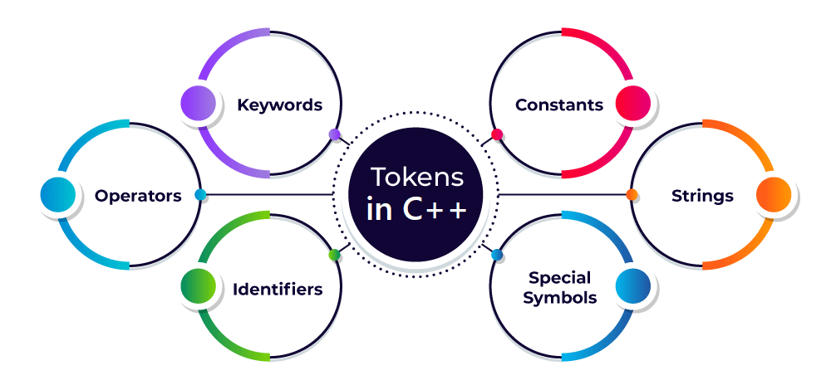
Tokens in C++
05
By Ramjilal Meena

Slide 14
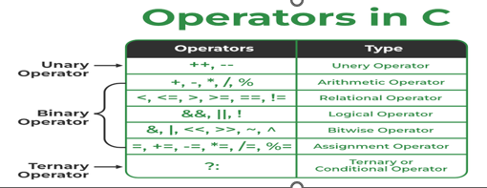
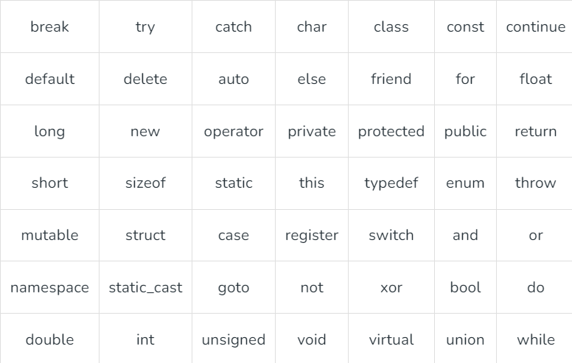
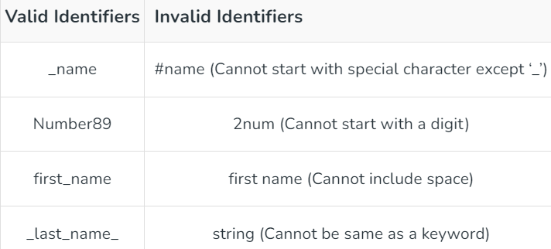

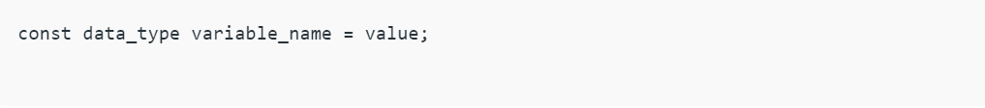
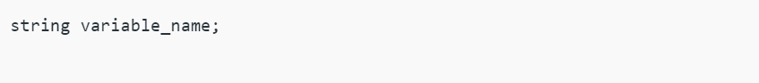
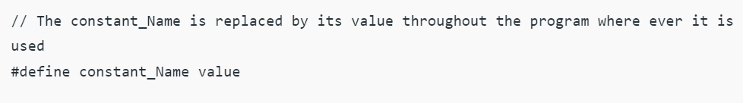
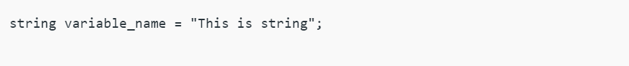
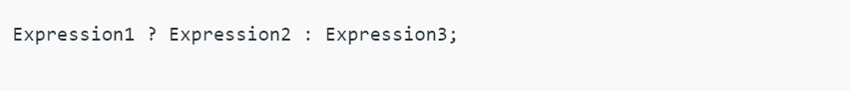
Tokens
Smallest individual element of the C++ programming language that is meaningful to the compiler.
It is the basic component of a C++ program.
Identifiers
Entities like variables, functions, classes, or structs must be given unique names within the program so that they can be uniquely identified.
The unique names given to these entities are known as Identifiers.
Rules to define the name of identifiers :
Can only begin with a letter or an underscore(_).
Can consist of letters (A-Z or a-z), digits (0-9), and underscores (_).
White spaces & Special characters can not be used.
Keywords cannot be used as an identifier because they are reserved words to do specific tasks. For example, string, int, class, struct, etc.
Identifier must be unique in its namespace.
As C++ is a case-sensitive language so identifiers such as ‘name’ and ‘Name’ are different entities.
Types of Operators
Unary Operators
Binary Operators
Ternary Operators
Most common special symbols used in C++ programming:
Semicolon ; - It is used to terminate the statement.
Square brackets [] - They are used to store array elements.
Curly Braces {} - They are used to define blocks of code.
Scope resolution (::) - Scope resolution operator is used to access members of namespaces, classes, etc.
Dot (.) - Dot operator also called member access operator used to access class and struct members.
Assignment operator (=) - This operator is used to assign values to variables.
Double-quote (“) - It is used to enclose string literals.
Single-quote (‘) - It is used to enclose character literals.
Keywords
These are the reserved words in programming language that have their specific meaning and functionalities within a program.
Keywords cannot be used as an identifier to name any variables.
Constants
Constants are the tokens in C++ that are used to define variables at the time of initialization and the assigned value cannot be changed after that.
We can define the constants in C++ in two ways that are using the ‘const’ keyword and ‘#define’ preprocessor directive.
Strings
In C++, a string is not a built-in data type like ‘int’, ‘char’. It is a class available in the STL library which provides the functionality to work with a sequence of characters, that represents a string of text.
When we define any variable using the ‘string’ keyword we are actually defining an object that represents a sequence of characters. We can perform various methods on the string provided by the string class such as length(), push_back(), and pop_back().
Special Symbols
Special symbols are the token characters having specific meanings within the syntax of the programming language.
Operators
C++ operators are special symbols that are used to perform operations on operands such as variables, constants, or expressions.
A wide range of operators is available in C++ to perform a specific type of operations which includes arithmetic operations, comparison operations, logical operations, and more.
Unary Operators
Unary operators are used with single operands only.
They perform the operations on a single variable.
Increment operator (++): It is used to increment the value of an operand by 1.
Decrement operator (–): It is used to decrement the value of an operand by 1
Binary Operators
They are used with the two operands, and they perform the operations between the two variables. For example (A<B), less than (<) operator compares A and B, returns true if A is less than B else returns false.
Ternary Operator
The ternary operator is the only operator that takes three operands.
It is also known as a conditional operator that is used for conditional expressions.

Slide 15
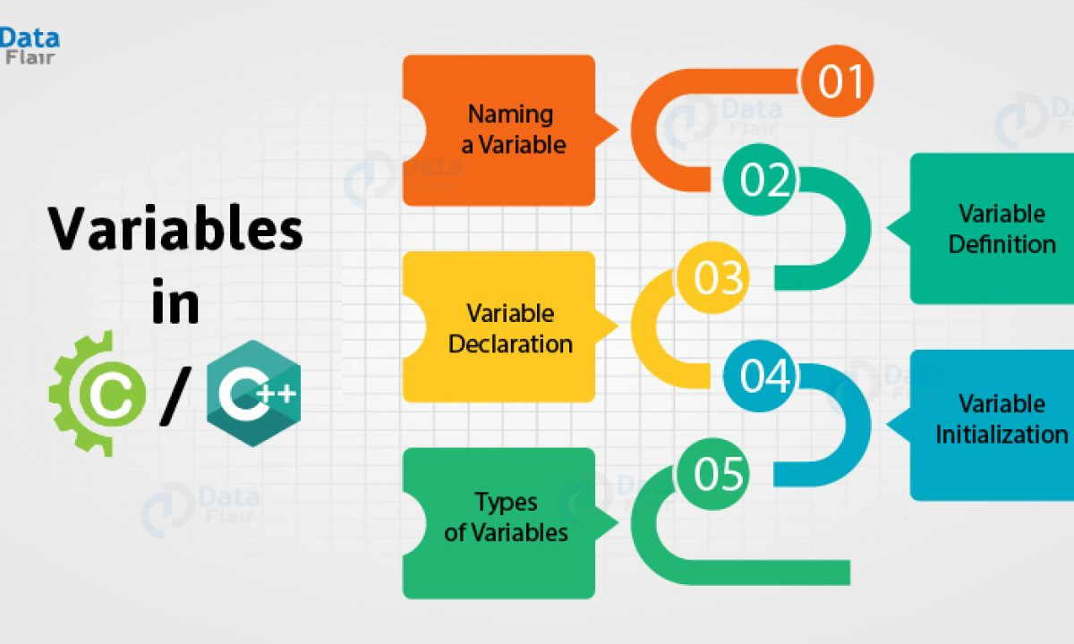
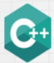

Variables & Constants
|Declaration, Definition & Initialization
06
By Ramjilal Meena

Slide 16
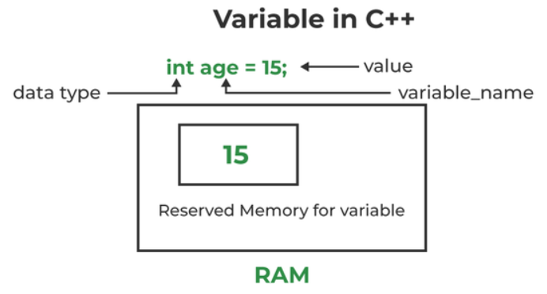
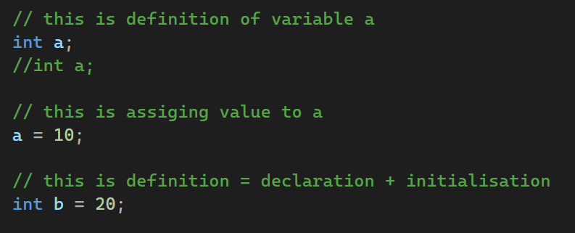
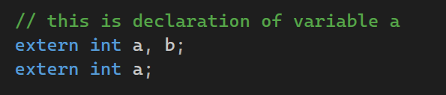
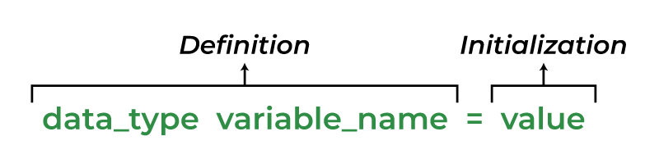
Variables in C++
Variables is a name given to a memory location. It is the basic unit of storage in a program.
The value stored in a variable can be changed during program execution.
All the operations done on the variable effects that memory location.
All the variables must be declared before use.
Rules to define the name of identifiers :
Can only begin with a letter or an underscore(_).
Can consist of letters (A-Z or a-z), digits (0-9), and underscores (_).
White spaces & Special characters can not be used.
Keywords cannot be used as an identifier because they are reserved words to do specific tasks. For example, string, int, class, struct, etc.
Identifier must be unique in its namespace.
As C++ is a case-sensitive language so identifiers such as ‘name’ and ‘Name’ are different entities.
There are 3 aspects of defining a variable:
Declaration – Only existence, No memory is allocated.
Definition – Memory allocation with some value.
Initialization – Assigning some value.
How to Declare a Variable?
(Only existence, No memory is allocated.)
// Declaring a single variable
Data_type variable_name;
// Declaring multiple variables:
Data_type variable1_name, variable2_name, variable3_name;
How to Define a Variable?
(Memory allocation with some value.)
A variable definition is a part where the variable is assigned a memory location and a value.
Most of the time, variable declaration and definition are done together.
How to Initialize a Variable?
(Assigning some value.)
// Initialization
Data_type variable_name = value;
// Assigning some value
variable_name = value1;

Slide 17
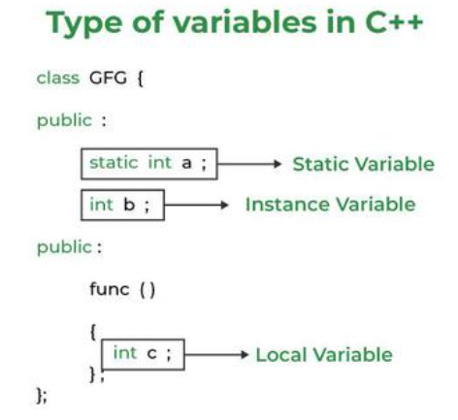
Variables Types
There are three types of variables based on the scope of variables in C++
Local Variables
Instance Variables
Static Variables
Instance Variable Vs Static Variable
Each object will have its own copy of the instance variable whereas We can only have one copy of a static variable per class irrespective of how many objects we create.
Changes made in an instance variable using one object will not be reflected in other objects as each object has its own copy of the instance variable. In the case of static, changes will be reflected in other objects as static variables are common to all objects of a class.
We can access instance variables through object references and Static Variables can be accessed directly using the class name.
Local Variables
A variable defined within a block or function is called a local variable.
These variables are created when entered into the block or the function is called and destroyed after exiting from the block or when the call returns from the function.
The scope of these variables exists only within the block in which the variable is declared. i.e. we can access this variable only within that block.
Initialization of Local Variable is Mandatory.
Instance Variables
Instance variables are non-static variables and are declared in a class outside any method, constructor, or block.
As instance variables are declared in a class, these variables are created when an object of the class is created and destroyed when the object is destroyed.
Unlike local variables, we may use access specifiers for instance variables. If we do not specify any access specifier then the default access specifier will be used.
Initialization of Instance Variable is not Mandatory.
Instance Variable can be accessed only by creating objects.
Static Variables
Static variables are also known as Class variables.
These variables are declared similarly as instance variables, the difference is that static variables are declared using the static keyword within a class outside any function or block.
Unlike instance variables, we can only have one copy of a static variable per class irrespective of how many objects we create.
Created at the start of program execution and destroyed automatically when execution ends.
If we access the static variable like the Instance variable (through an object), the compiler will show the warning message and it won’t halt the program. The compiler will replace the object name with the class name automatically.
If we access the static variable without the class name, the Compiler will automatically append the class name.
Initialization of Static Variable is not Mandatory. Its default value is 0

Slide 18
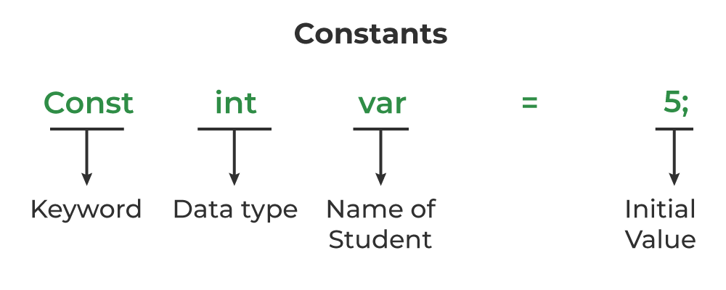
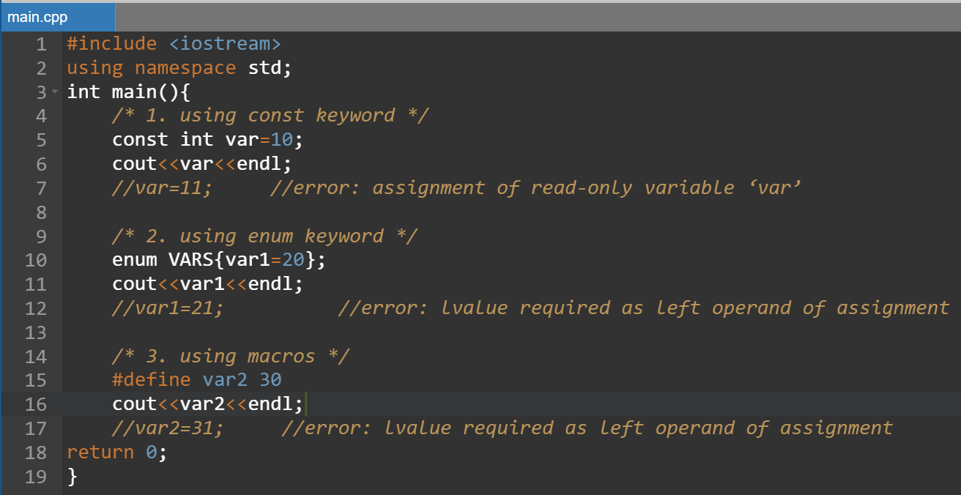
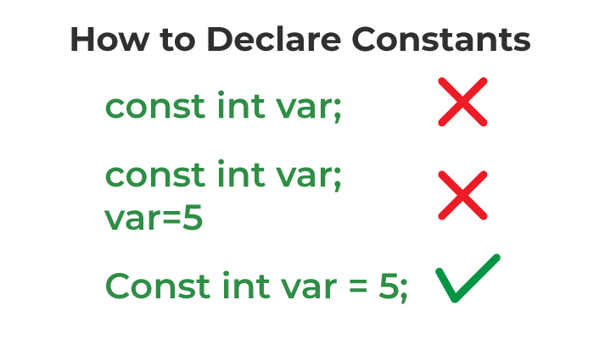
Constants Variables | Advantages of constant
A constant is a variable that cannot be modified once it is declared in the program.
We can not make any change in the value of the constant variables after they are defined.
Advantages of const Qualifier
Improved Code Readability
Enhanced Type Safety
Improved Optimization
Better Memory Usage
Improved Compatibility
Improved Reliability
There are 3 ways to declare Constant Variables
Is there any way to change the value of a constant variable in C++?

Slide 19
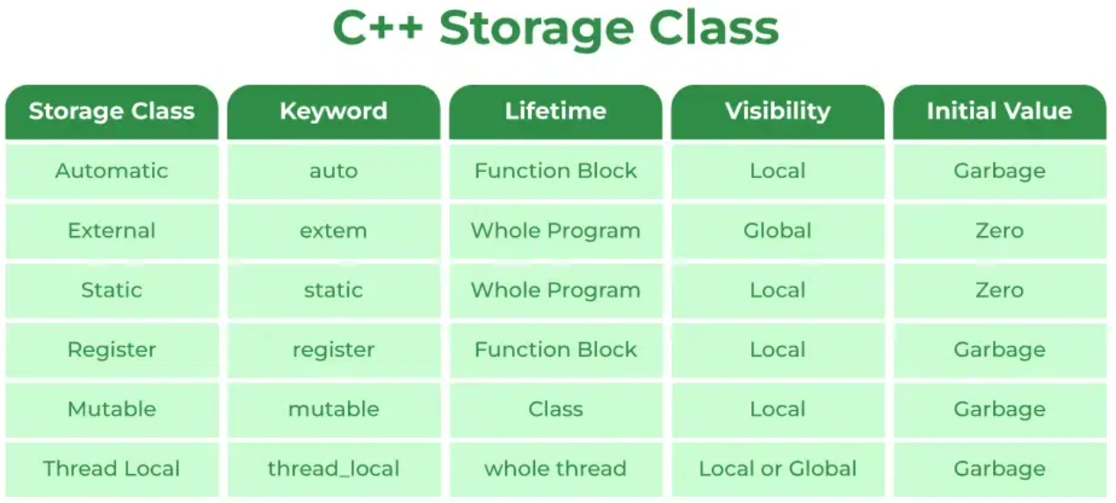
Storage Classes
|Types, Properties & Usage
07
By Ramjilal Meena

Slide 20
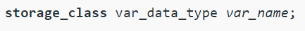
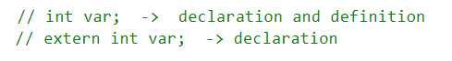
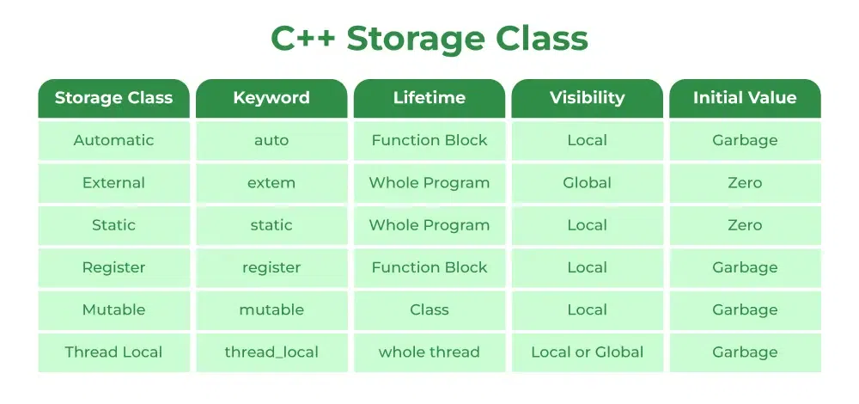
Storage Classes
Storage Classes are used to describe the features of a variable/function.
These features includes the storage type, initial value, scope & lifetime.
Help to trace the existence of a particular variable during the runtime of a program.
Multiple storage class specifiers are not allowed for a variable.

Slide 21
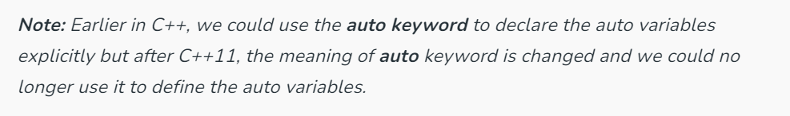
Storage Classes
Automatic
Default storage class for all the variables declared inside a function or a block. Hence, the keyword auto is rarely used.
Auto variables can be only accessed within the block/function ( and nested blocks) they have been declared (which defines their scope).
However, they can be accessed outside their scope as well using the pointers, with the exact memory location where the variables reside.
They are assigned a garbage value by default whenever they are declared.
External
The extern storage class simply tells that the variable is defined elsewhere and not within the same block where it is used (i.e. external linkage).
When an extern variable is initialized, then memory for this is allocated and it will be considered defined.
A variable or function can be declared any number of times, but it can be defined only once. (Remember the basic principle that you can’t have two locations of the same variable or function).
The extern variable says to the compiler “Go outside my scope and you will find the definition of the variable that I declared.”
The compiler believes that whatever that extern variable said is true and produces no error. Linker throws an error when it finds no such variable exists.
The extern keyword is used to extend the visibility of variables/functions.
Since functions are visible throughout the program by default, the use of the extern is not needed in function declarations or definitions. Its use is implicit.
Static
Initialized only once and exist till the termination of the program. Thus, no new memory is allocated because they are not re-declared.
Scope is local to the function to which they were defined. Global static variables can be accessed anywhere in the file.
Static global variables and functions are also possible in C/C++. The purpose of these is to limit the scope of a variable or function to a file.
Static variables should not be declared inside a structure.
register
This storage class declares register variables that have the same functionality as that of the auto variables.
Compiler tries to store these variables in the register of the microprocessor if a free register is available.
Much faster than that of the variables stored in the memory during the runtime of the program.
register can only be used within a block (local), it can not be used in the global scope (outside main).
There is no limit on the number of register variables, but the point is compiler may put some variables in the register and some not.
mutable
Sometimes there is a requirement to modify one or more data members of class/struct through the const function even though you don’t want the function to update other members of class/struct. This task can be easily performed by using the mutable keyword.
The keyword mutable is mainly used to allow a particular data member of a const object to be modified.
When we declare a function as const, this pointer passed to the function becomes const.
Adding a mutable to a variable allows a const pointer to change members.
thread_local
The thread_local Storage Class is the new storage class that was added in C++11.
We can use the thread_local storage class specifier to define the object as thread_local.
The thread_local variable can be combined with other storage specifiers like static or extern and the properties of the thread_local object changes accordingly.
Hands-on Example…

Slide 22
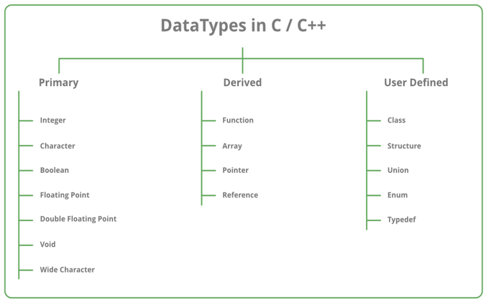
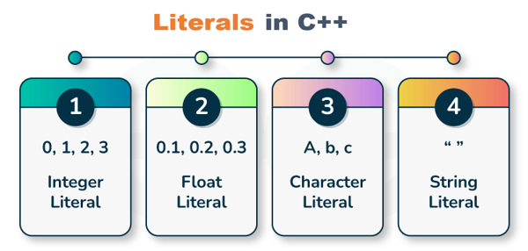
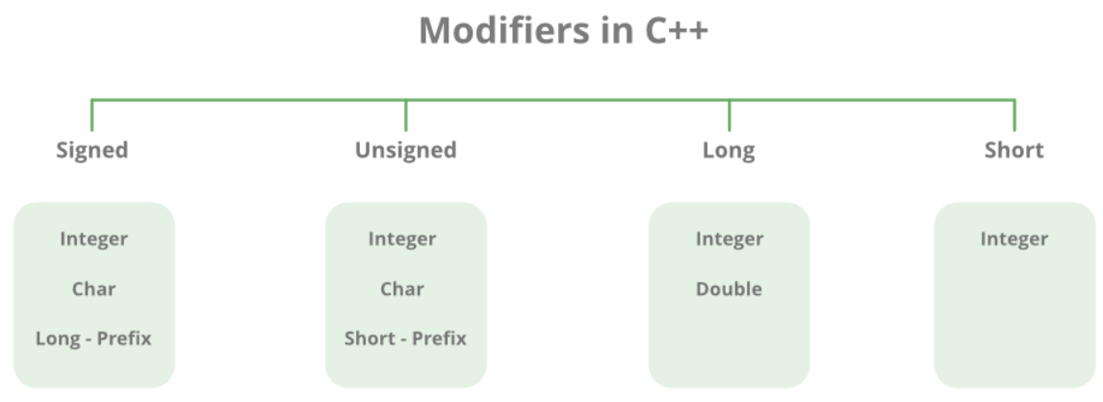
Data Types in C++
|Primary, Derived & User-Defined
08
By Ramjilal Meena

Slide 23
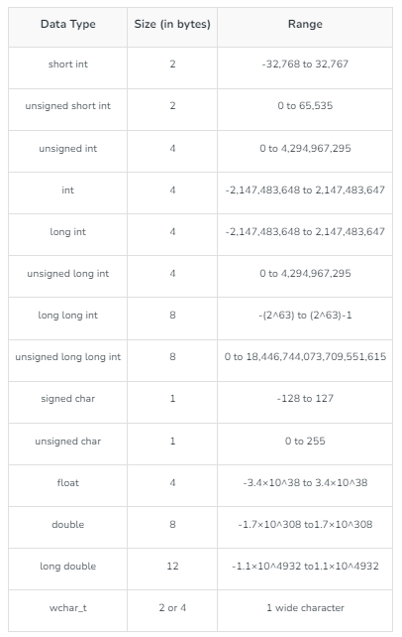
Data Types in C++
C++ supports the following data types:
Primary or Primitive or Built-in or Fundamental data type
Derived data types
User-defined data types
32-bit GCC compiler-based ranges
Whenever a variable is defined in C++, the compiler allocates some memory for that variable based on the data type with which it is declared.
Each variable in C++ has an associated data type.
Data types are used to tell the variables the type of data they can store. like int, char.
Each data type requires different amounts of memory and has some specific operations which can be performed over it.
Different data types also have different ranges up to which they can store numbers. These ranges may vary from compiler to compiler.
Primitive Data Types
Can be used directly by the user to declare variables.
Primitive data types available in C++ are:
Integer - int
Character - char
Boolean - bool
Floating Point - float
Double Floating Point - double
Valueless or Void - void
Wide Character – wchar_t
Derived Data Types
Derived from the primitive or built-in datatypes.
These can be of four types :
Function
Array
Pointer
Reference
Abstract or User-Defined Data Types
Defined by the user itself. Like, defining a class in C++ or a structure.
C++ provides the following user-defined datatypes:
Class
Structure
Union
Enumeration
Typedef defined Datatype

Slide 24
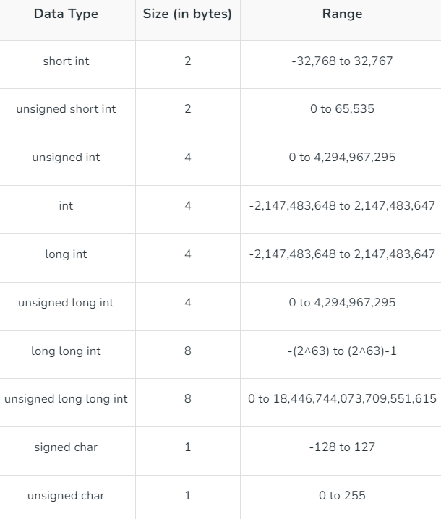
Datatype Modifiers
Advantages of Data Types:
Data types provide a way to categorize and organize data in a program, making it easier to understand and manage.
Each data type has a specific range of values it can hold, allowing for more precise control over the type of data being stored.
Data types help prevent errors and bugs in a program by enforcing strict rules about how data can be used and manipulated.
C++ provides a wide range of data types, allowing developers to choose the best type for a specific task.
Disadvantages of Data Types:
Using the wrong data type can result in unexpected behavior and errors in a program.
Some data types, such as long doubles or char arrays, can take up a large amount of memory and impact performance if used excessively.
C++’s complex type system can make it difficult for beginners to learn and use the language effectively.
The use of data types can add additional complexity and verbosity to a program, making it harder to read and understand.
As the name suggests, datatype modifiers are used with built-in data types to modify the length of data that a particular data type can hold.
Hands-on Example…
32-bit GCC compiler-based ranges

Slide 25
Literals in C++
Literals are the Constant values that are assigned to the constant variables.
Literals represent fixed values that cannot be modified.
Literals contain memory but they do not have references as variables.
Generally, both terms, constants, and literals are used interchangeably.
For example, “const int = 5;” is a constant expression and the value 5 is referred to as a constant integer literal.
Hands-on Example…

Slide 26
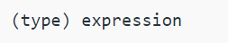
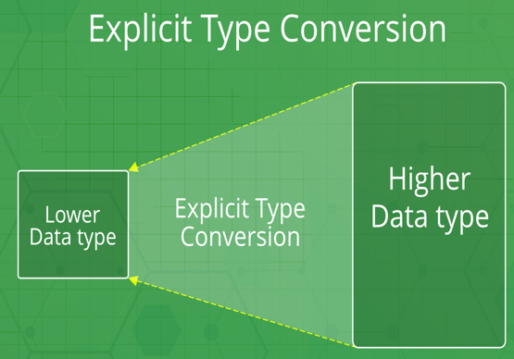
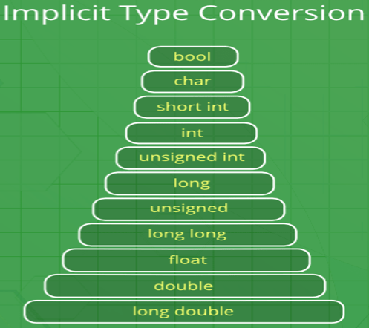
Type Conversion in C++
Implicit Type Conversion (automatic type conversion)
No arithmetic operation happens on smaller types like char, short and enum.
They are first converted to int or unsigned int, and then arithmetic is done on them.
Done by the compiler on its own, without any external trigger from the user.
Generally takes place when in an expression more than one data type is present. In such condition type conversion (type promotion) takes place to avoid lose of data.
All the data types of the variables are upgraded to the data type of the variable with largest data type.
Example bool -> char -> short int -> int -> unsigned int -> long -> unsigned -> long long -> float -> double -> long double
lose information, signs can be lost (signed -> unsigned)
overflow can occur (long -> float)
The process of converting one data type to another.
Type conversion is performed by a compiler.
The destination data type should not be smaller than the source data type.
There are two types of Conversion:
Implicit Type Conversion
Explicit Type Conversion
Explicit Type Conversion (type casting )
Done by Programmer.
User can typecast the result to make it of a particular data type.
There are two way:
1. Converting by assignment: (forceful casting)
→ (type) expression
where type indicates the data type to which the final result is converted.
2. Conversion using Cast operator :
A Cast operator is an unary operator which forces one data type to be converted into another data type.
C++ supports four types of casting:
static_cast
dynamic_cast
const_cast
reinterpret_cast
Hands-on Example…

Slide 27
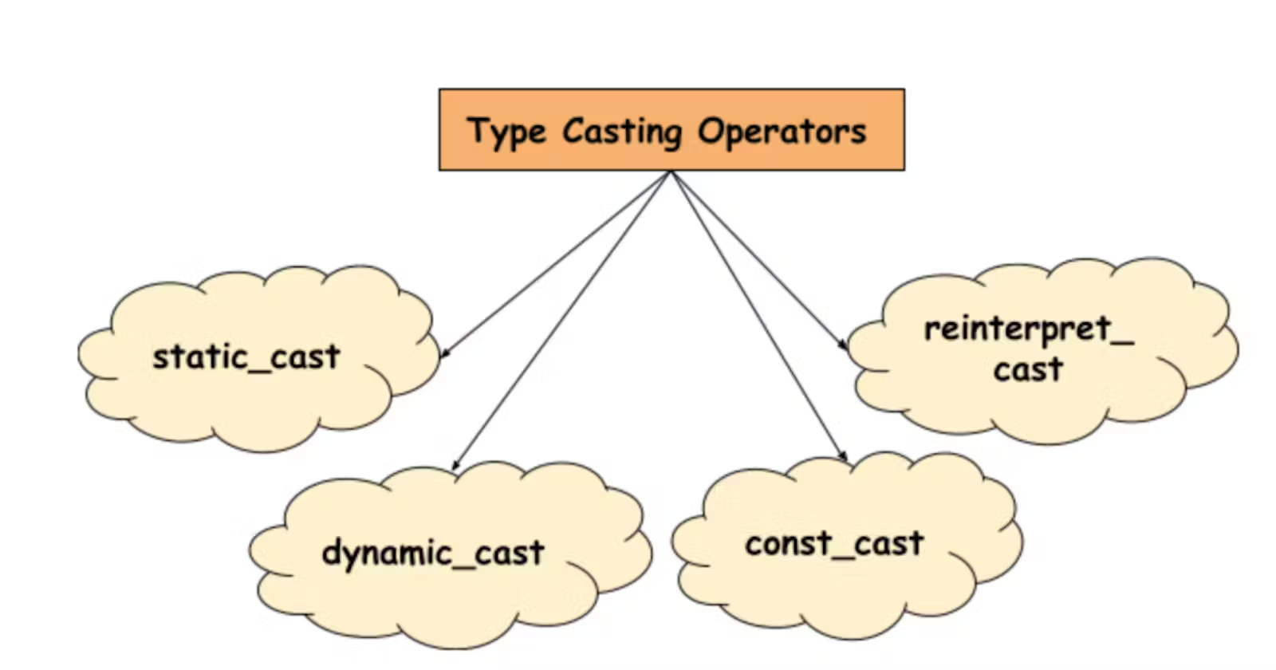
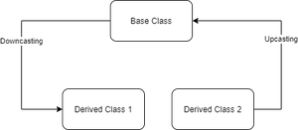
Type Casting Operators
|static_cast, dynamic_cast, const_cast, reinterpret_cast
10
By Ramjilal Meena

Slide 28
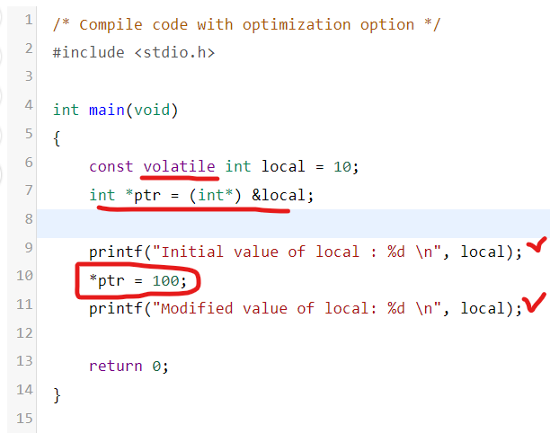
Cast Operators in C++
Casting operators are used for type casting in C++.
They are used to convert one data type to another.
C++ supports four types of cast operators
static_cast
dynamic_cast
const_cast
reinterpret_cast
volatile :
volatile variable –> don’t do compiler optimization for that variable“!
The volatile keyword is intended to prevent the compiler from applying any optimizations on objects that can change in ways that cannot be determined by the compiler.
Hands-on Example…

Slide 29
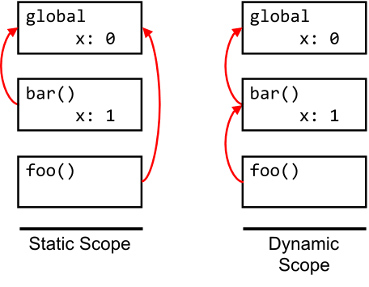
Scoping in C++
11
By Ramjilal Meena

Slide 30
Scoping in C++ |Static & Dynamic
The scope of a variable x in the region of the program, where it is visible & accessible.
To keep variables in different parts of the program distinct from one another.
Static Scoping
Static scoping is also called lexical scoping.
Compiler first searches in the current block -> global variables -> successively smaller scopes.
Example C, C++, and Java.
Dynamic Scoping
Compiler first searches the current block -> successively in all the calling functions.
Example Perl.

Slide 31
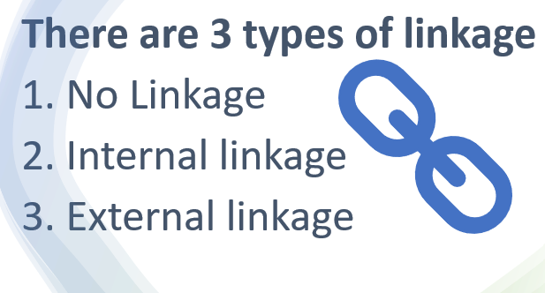
Linkage In C++
12
By Ramjilal Meena

Slide 32
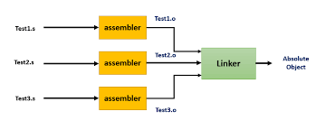

Linkage in C++?
Scope : Visibility or Accessibility of an identifier
Scope is a property handled by compiler, whereas linkage is a property handled by linker.
Translation Unit :
a file containing source code, header files and other dependencies.
a basic unit which are independently compliable by the compiler.
Linkage :
Linkage is a property of a variable name.
During compilation, Each Translation unit is compiled to generate the corresponding object file(*.obj).
During linking time, All object files are processed by linker and generates machine code for application.
The Linker is a program that takes multiple object files as input and produces an executable.
It resolves symbols and arranges objects in address space.

Slide 33
Understanding Linkage
Internal linkage
Here, the name can be referred to/from all scopes in the current translation unit.
variables, functions, or function templates declared static
Any identifier within the unit can access an identifier having internal linkage.
Stored in initialized or uninitialized segment of RAM.
Not accessible outside the translation unit it is declared in.
Hands-on Example…
External linkage
Here, the name can be referred to/from any translation units.
Any of the following names declared at namespace scope have
Identifiers declared with extern
Identifiers not declared static,
visible to every translation unit.
Stored in initialized/uninitialized or text segment of RAM
No Linkage
Names not specified with external/internal linkage -> have no linkage.
after compilation, there is no such name(with no linkage) exists in program.

Slide 34

Input/Output Streams & Manipulators
| iostream, iomanip, fstream, bits/stdc++
13
By Ramjilal Meena

Slide 35
Input/Output Streams & Manipulators
Many ways for performing input and output with C++ libraries.
Input/output are performed in the form of a sequence of bytes (streams).
Input Stream: Device(Keyboard) → Main Memory.
Output Stream: Main Memory → Device( Display screen ).
Parameterized Manipulators
Manipulator -> Meaning setw (int n) -> To set field width to n setprecision (int p) -> The precision is fixed to p setfill (Char ch) -> To set the character to be filled Setbase(int b) -> To set the base of the number to b
Non-parameterized Manipulators
endl – Gives a new line
ends – Adds null character to close an output string
flush – Flushes the buffer stream
ws – Omits the leading white spaces present before the first field
hex, oct, dec – Displays the number in respective format
Header files available in C++ for Input/Output operations:
iostream: standard input-output stream. Example cin, cout, cerr, etc.
iomanip: input-output manipulators. Example setw, setprecision, etc.
fstream: file stream. Handle operations related to file.
bits/stdc++: includes every standard library.
<istream> important manipulators:
cin.getline(char *buffer, int N): reads a stream of characters of length N into string buffer
cin.get(char& var): It reads an input character and stores it in a variable.
cin.read(char *buffer, int N): Reads a stream of characters of length N.
<fstream> manipulators:
open () & close ()
get () & put()
read() & write()
<ostream> important manipulators:
cout.write(char *str, int n): Print the first N character reading from str.
cout.put(char &ch): Print the character stored in character ch.
cout.precision(int n): Sets the decimal precision to N, when using float values.

Slide 36
Type Conversion/Casting
|static_cast, dynamic_cast, const_cast, reinterpret_cast
09
By Ramjilal Meena

Slide 37

Conditional Statements
14
By Ramjilal Meena
Explanation with Code Examples

Slide 38







If, if-else, if-else-if
Decision control structures
Decision-Making, whether to execute a set of statements or not.
Decide the direction of the flow of program execution.

Slide 39


Switch statements
Rules of Switch case statements:
Case value must be constant integral e.g. int, char.
There can be any number of cases.
No duplicate case values are allowed.
Each statement of the case can have a break statement. It is optional.
The default Statement is also optional.
Advantages of switch Statement in C++
Easy to debug & maintain for large number of conditions.
Faster execution speed.
Easier to read than if else if.
Disadvantages of switch Statement in C++
Switch case can only evaluate int or char type.
No support for logical expressions.
Have to keep in mind to add a break in every case.
range in switch → Example

Slide 40

Loops in C++
|for, while, do-while & Nested Loops
15
By Ramjilal Meena
Explanation with Code Examples

Slide 41



What is Loop & Types?
Used to repeat a block of code until the specified condition is met.
Responsible for performing repetitive tasks.

Slide 42






Loops : for, while, do-while

Slide 43

Jump Statements
|goto, continue, break & return
16
By Ramjilal Meena
goto
continue
break
return
Explanation with Examples

Slide 44







Continue & Break

Slide 45




goto & return

Slide 46
foreach Vs for_each in C++
|foreach, range based for loop
17
By Ramjilal Meena
foreach
for_each
Explanation with Examples

Slide 47


Foreach or Range-based for loop
Used to iterate over the elements of a container (array, vectors) quickly without performing initialization, testing, & increment/decrement.
foreach loop iterates for every element rather than doing something n times.
Advantages of foreach loop:
Makes the code more readable.
Eliminates the errors of over-running or under-running the data.
Disadvantage of foreach loop:
Cannot iterate over the elements in reverse order.
Each & every element will be accessed, cannot skip any elements in between.

Slide 48


for_each loop
Accepts a function which executes over each of the container elements.
Defined in the header file “algorithm”: #include<algorithm>
It is versatile, i.e. Can work with any container.
It reduces chances of errors one can commit using generic for loop
It makes code more readable
for_each loops improve overall performance of code

Slide 49


Functions in C++
|user-defined & library functions
Part-1
18
By Ramjilal Meena
Declaration
Definition
Arguments
Explanation with Examples
Function call

Slide 50



Functions??
A set of statements, Perform some specific task.
In simple terms, a function is a block of code that runs only when it is called.
Why Do We Need Functions?
Reduce code redundancy – keep only unique code block (single version of code)
Modularity & readable – divides in small-small modules
Abstraction – library functions.
pow(), sqrt()
Advantages of User-Defined Functions
Changeable functions can be modified as per need.
The Code of these functions is reusable in other programs.
These functions are easy to understand, debug and maintain.
Advantages of C++ library functions
Easy to use & optimized for better performance.
Save a lot of time i.e. function development time.
Convenient as they always work.
3 Aspects of functions
Function Declaration.
Function Definition.
Function Calls.

Slide 51



Functions : Declaration, Definition & Call
Function Declaration
Tells compiler about signature of the function.
The parameter name is not mandatory while declaring functions.
3 Aspects of functions-
Function Declaration
Function Definition
Function Calls
Function Definition
Consists of actual statements which are executed when the function is called.
A C++ function is generally defined and declared in a single step.
Function Call
A statement that instructs the compiler to execute the function.
Use the function name and parameters in the function call.

Slide 52




Arguments passing techniques
Terminology
Formal Parameter: Appear in the prototype of the function.
Actual Parameter: (Arguments) Appears in the function call in the calling environment.
Modes → (IN, OUT, IN/OUT)
Parameter Passing Techniques
1. Pass by Value 2. Pass by Pointers 3. Pass by Reference
Default Arguments

Slide 53
Functions in C++
|C++ Special functions
Part-2
19
By Ramjilal Meena
C++ Special functions
Main function
Inline function
Cmd line Args
Lambda function
Variadic function
Friend Function
Explanation with Examples

Slide 54







C++ Special functions main(), Cmd line Args & Variadic function
Main function & command line arguments
An integral part of the programming languages such as C, C++.
Entry point of a program where the execution of a program starts.
A user-defined function that is mandatory for the execution of a program.
Variadic function
Special function, which can take any number of arguments.
No need to define the argument list at declaration.
Types of Main Functions
1. Without parameters:
2. With parameters:

Slide 55




C++ Special functions Inline, Lambda & Friend functions
Inline Function
Reduce the function call overhead.
An inline function is a function that is expanded in line when it is called.
Inlining is only a request to the compiler, not a command. The compiler can ignore the request for inlining.
Inlining happens at compile time.
The compiler may not perform inlining in such circumstances as:
If a function return type is other than void, and the return statement doesn’t exist in a function body.
If a function contains a loop. (for, while and do-while)
If a function contains static variables.
If a function is recursive.
If a function contains a switch or goto statement.
If a function is virtual.
Lambda expression (C++11)
Introduced to allow inline functions which can be used for short snippets of code that are not going to be reused and therefore do not require a name.
A lambda expression can have more power than an ordinary function by having access to variables from the enclosing scope.
Friend Function
A special function in C++ which in spite of not being a member function of a class has the privilege to access private & protected data of a class.
A friend function is a non-member function of a class, which is declared by using the keyword “friend” inside the class.
By declaring a function as a friend, all the access permissions are given to the function.
The keyword “friend” is placed only in the function declaration but not in the function definition.
When the friend function is called neither the name of the object nor the dot operator is used. However, it may accept the object as an argument whose value it wants to access.
A friend function can be declared in any section of the class i.e. public, private, or protected.

Slide 56



Pointers in C++
Part-1
20
By Ramjilal Meena
Explanation with Examples

Slide 57




Pointer Types in C++
Part-2
21
By Ramjilal Meena
Explanation with Examples

Slide 58


Double Pointer in C++
Part-3
22
By Ramjilal Meena
Explanation with Examples

Slide 59


Size of Pointers
Part-4
23
By Ramjilal Meena
Advantages
Disadvantages
&
Explanation with Examples

Slide 60

Nullptr & NULL
Part-5
24
By Ramjilal Meena
Explanation with Examples
nullptr
NULL

Slide 61



Pointers Arithmetic's
Part-6
25
By Ramjilal Meena
Explanation with Examples

Slide 62



Pointers with Array
Part-7
26
By Ramjilal Meena
Explanation with Examples

Slide 63


Arrays & Pointers
Arrays and Pointers are closely related
We can use pointers to perform all the possible operations of the array.
Array name is a constant pointer to the first element of the array.
Array decays to the pointers when passed to the function.
Passing & Returning an Array to/from a Function
An array is always passed as pointers.
Pass an array to a function, it decays to the pointer.
Return using a pointer to the first element of that array. (Function can only return single value)

Slide 64


Functions Pointers
Part-8
27
By Ramjilal Meena
Explanation with Examples

Slide 65



References in C++
|Detailed Explanation with examples
28
By Ramjilal Meena
Explanation with Examples

Slide 66



Array in C++
Part-1
29
By Ramjilal Meena
Explanation with Examples

Slide 67


C++ Array
A fixed-size collection of similar data items stored in contiguous memory locations.
Primitive, Derived and User-defined data types can be stored.
Array of void and functions is not allowed in C++
Properties of Arrays
Fixed Size Collection
Homogeneous Elements
Indexing in Array (0 to N-1)
Dimensions of Array
Contiguous Storage
Random Access
Array name relation with pointer
No Index Out of Bounds Checking
Array Decay

Slide 68




C++ Array
1. Array Initialization with Declaration
2. Array Initialization with Declaration without Size
3. Array Initialization after Declaration (Using Loops)
4. Initialize an array partially
5. Initialize the array with zero. (Does not work for other value)

Slide 69



Array : Access Elements
using the array subscript operator [ ] and the index value i of the element.
Update Array Element
can update the value of an element at the given index i
using the array subscript operator [ ] and assignment operator =.

Slide 70
Length of Array
Length of Array
Don’t have any pre-defined function to find the length of the array.
Using sizeof() Operator
// Length of an array
int n = sizeof(arr) / sizeof(arr[0]);
Using Pointer Arithmetic
// Length of an array
int n = *(&arr+1) – arr;
Using for Loop
It iterates through all the elements of an array & increments count.
// Length of an array
int count = 0;
for(int i : arr){ count++; }
Advantages of Array
Random and fast access of elements using the array index.
Use of fewer lines of code as it creates a single array of multiple elements.
Traversal through the array becomes easy using a single loop.
Sorting becomes easy as it can be accomplished by writing fewer lines of code.
Disadvantages of Array
Allows a fixed number of elements to be entered which is decided at the time of declaration.
Insertion & deletion of elements is costly since elements are needed to be rearranged after insertion & deletion.

Slide 71

Array in C++
|Multi-dimensional, Jagged
Part-2
30
By Ramjilal Meena
Explanation with Examples

Slide 72



Types of Array in C++
Single Dimensional Arrays (1D Array)
data_type array_name[Size_of_array];
Multidimensional Arrays
Data_Type Array_Name[Size1][Size2]...[SizeN];

Slide 73



Multidimensional Array
Array of arrays that stores homogeneous data in tabular form.
Data is generally stored in row-major order in the memory.
Left most dimensions as optional, all other dimensions must be specified.
Size of Multidimensional Arrays: (Multiply all dimensions)
The array int x[10][20] can store total (10*20) = 200 elements.
Size of array int x[10][20] = 10 * 20 * 4 = 800 bytes. (where int = 4 bytes)
Initialization of Two-Dimensional Arrays in C
Using Initializer List -
Using Loops

Slide 74


Jagged Array
Array of Arrays such that member arrays can be of different sizes.

Slide 75
Array in C++
|Pass / Return array to/from function, array decay
Part-3
31
By Ramjilal Meena
Explanation with Examples

Slide 76



C Style String
|String in C++
Part-1
32
By Ramjilal Meena
Explanation with Examples

Slide 77


C Style String
An array of characters. A sequence of characters terminated with a null character ‘\0’ stored at contiguous location.
Difference between a character array and a C style string is the string is terminated with a unique character ‘\0’.
C style String Initialization
Assigning a string literal without size
Assigning a string literal with a predefined size (one extra character always)
Assigning character by character with size
Assigning character by character without size
Read a String Input From the User → %s
Note: When a Sequence of characters enclosed in the double quote, ‘\0’ is appended at the end of the string by default.
Note: After declaration, if we want to assign some other text to the string, we have to assign it one by one or use built-in strcpy() function because the direct assignment of string literal to character array is only possible in declaration.

Slide 78




Array of String
Hands-on Example…

Slide 79

String.h Header file

Slide 80


C++ String Class
|String in C++
Part-2
33
By Ramjilal Meena
Explanation with Examples

Slide 81
String.h Header file

Slide 82






Structure in C++
|Detailed Explanation
34
By Ramjilal Meena

Slide 83
Structures
A user-defined data type.
It provide a method for packing together data of different types & functions.
It is a helpful tool to handle a group of logically related data items.
Can be used to group items of possibly different types into a single type.
struct keyword is used to define the structure.
Items in the structure are called its member & they can be of any valid data type.

Slide 84




Structure
|Declaration, Definition & Accessing element
1. C Structure Declaration
2. C Structure Definition
1. Structure Variable Declaration with Structure Template
2. Structure Variable Declaration after Structure Template
Called a structure template or structure prototype.
No memory is allocated to the structure in the declaration.
3. Access Structure Members
Using dot(.) & Arrow(->) Operators.

Slide 85


Structure
|Initialization
Structure members can be initialized with the declaration in C++11 onwards.
1. Initialization using Assignment Operator
3. Initialization using Designated Initializer List
2. Initialization using Initializer List

Slide 86




Structure
|Nested & Self-Referential Structure, Structure Pointer
C++ language allows us to insert one structure into another as a member.
1. Embedded Structure Nesting
2. Separate Structure Nesting
Accessing Nested Members
Self-Referential Structures
Structure Pointer

Slide 87

Structure
|Flexible Array Member in structure
We can declare an array without a dimension and whose size is flexible in nature.
Should be declared as the last member of the structure and its size is variable(can be changed at runtime).
The structure must contain at least one more named member in addition to the flexible array member.
The flexible array member does not contribute to the size of the structure itself.

Slide 88
Structure
|C Vs C++ Structure
C Structures | C++ Structures
Only data members are allowed, it cannot have member functions. | Can hold both: member functions and data members.
Cannot have static members. | Can have static members.
Cannot have a constructor inside a structure. | Constructor creation is allowed.
Direct Initialization of data members is not possible. | Direct Initialization of data members is possible.
Writing the ‘struct’ keyword is necessary to declare structure-type variables. | Writing the ‘struct’ keyword is not necessary to declare structure-type variables.
Do not have access modifiers. | Supports access modifiers.
Only pointers to structs are allowed. | Can have both pointers and references to the struct.
Sizeof operator will generate 0 for an empty structure. | Sizeof operator will generate 1 for an empty structure.
Data Hiding is not possible. | Data Hiding is possible.

Slide 89


Structure
| Padding & Packing
Structure size should be the sum of the sizes of its members. But it may not be true.
Processor 32Bit → Word Size 4Byte or Processor 64Bit → Word Size 8Byte
Structure padding is the concept of adding one or more empty bytes between the different data types to align data in memory according to largest member size.
It increases memory consumption but reduces CPU read cycles.
Structure Packing is the concept to pack the structure tightly by removing the empty ( padded) bytes.
C++ language provides two ways for structure packing:
Using #pragma pack(1)
Using __attribute((packed))__
Bit Fields are used to specify the length of the structure members in bits.

Slide 90



Union in C++
|Detailed Explanation
37
By Ramjilal Meena

Slide 91
Union
A user-defined data type & It provides a method for packing together data of different types.
Can be used to group items of possibly different types into a single type.
Items in the union are called its member & they can be of any valid data type.
Member variables in a union share the same memory location.
Memory space can be used by one member variable at one point in time.
The size of the union is equal to the size of the largest data type.
// union template or declaration
union myunion {
int member1;
char member2;
double member3;
};
Need of Union in C++
When the available memory is limited, it can be used to achieve memory efficiency.
It is used to encapsulate different types of data members.
It helps in optimizing the performance of applications.

Slide 92




Union
| Declaration, Definition & Access
1. Union Declaration
2. Union Definition
3. Access Union Members
Using dot(.) & Arrow(->) Operators.
→ where var1 is the union variable and member1 is the member of the union.
No memory is allocated to the union in the declaration.
End the union declaration with a semi-colon.

Slide 93

Structure Vs Union
Union
| Initialization, Structure Vs Union
C++ Union members can be initialized with the declaration.
Initialization of its members by simply assigning the value to it.
only one member can contain some value at a given point of time.
// initializing/assign the union member
test1 test1_var;
test1_var1.y = 15;
union test1 {
int x=4;
int y;
};

Slide 94
Thank You
Please
Like
Subscribe
Comment

Slide 95


C++ Enum & typedef
|Detailed Explanation
38
By Ramjilal Meena

Slide 96


Enumeration In C
Enumeration (or enum) is a user defined data type in C.
used to assign names to integral constants, the names make a program easy to read and maintain.
Hands-on Example…

Slide 97


Enum Initialization
1. Two enum names can have same value.
2. If we do not explicitly assign values to enum names, the compiler by default assigns values starting from 0.
3. We can assign values to some name in any order. All unassigned names get value as value of previous name plus one.
4. The value assigned to enum names must be some integral constant, i.e., the value must be in range from minimum possible integer value to maximum possible integer value.
5. All enum constants must be unique in their scope. For example, the following program fails in compilation.

Slide 98


typedef In C
The typedef is a keyword that is used to provide existing data types with a new name.
Used to redefine the name of already existing data types.
Hands-on Example…
Use of typedef in C
The typedef keyword gives a meaningful name to the existing data type which helps other users to understand the program more easily.
It can be used with structures to increase code readability and we don’t have to type struct repeatedly.
The typedef keyword can also be used with pointers to declare multiple pointers in a single statement.
It can be used with arrays to declare any number of variables.
Hands-on Example…

Slide 99

typedef In C
C typedef vs #define
#define can define aliases for values as well, for instance, you can define 1 as ONE, 3.14 as PI, etc. Typedef is limited to giving symbolic names to types only.
Preprocessors interpret #define statements, while the compiler interprets typedef statements.
No semicolon at the end of #define, but a semicolon at the end of typedef.
typedef defines a new type by copying and pasting the definition values.

Slide 100

Memory Layout of C Programs
Memory Allocation
Memory Deallocation
Memory Leak
39
By Ramjilal Meena

Slide 101
Memory Layout of C Programs
Text Segment:
known as a code segment, is one of the sections of a program in an object file or in memory, which contains executable instructions.
Placed below the heap or stack to prevent heaps and stack overflows from overwriting it.
Sharable so that only a single copy needs to be in memory for frequently executed programs, such as text editors, the C compiler, the shells, and so on.
Read-only, to prevent a program from accidentally modifying its instructions.
Initialized Data Segment:
contains the global variables and static variables that are initialized by the programmer.
not read-only, since the values of the variables can be altered at run time.
It can be further classified into the initialized read-only area and the initialized read-write area.
global char s[] = “hello world” and global int debug=1 → initialized read-write area.
global const char* str = “hello world” makes the string literal “hello world” to be stored in the initialized read-only area and the character pointer variable str in the initialized read-write area.
Ex: static int i = 10 and global int i = 10 will be stored in data segment
Uninitialized Data Segment:
often called the “bss” segment → “block started by symbol.”
Data in this segment is initialized by the kernel to arithmetic 0, which do not have explicit initialization in source code.
Ex. Global static int I and global int j; would be contained in the BSS segment.

Slide 102
Memory Layout of C Programs
Stack:
The stack area traditionally adjoined the heap area and grew in the opposite direction.
when the stack pointer met the heap pointer, free memory was exhausted. (With modern large address spaces and virtual memory techniques they may be placed almost anywhere, but they still typically grow in opposite directions.)
The stack area contains the program stack, a LIFO structure, typically located in the higher parts of memory.
A “stack pointer” register tracks the top of the stack; it is adjusted each time a value is “pushed” onto the stack.
The set of values pushed for one function call is termed a “stack frame”. It consists a return address and address of automatic variables.
Heap:
Heap is the segment where dynamic memory allocation usually takes place.
The heap area begins at the end of the BSS segment and grows to larger addresses from there.
The Heap area is managed by malloc, realloc, and free, which may use the brk and sbrk system calls to adjust its size.

Slide 103




Memory Layout
1. Check the following simple C program
2. Let us add one global variable in the program, now check the size of bss

Slide 104




Memory Layout
3. Let us add one local static variable which is also stored in bss.
4. Let us initialize the static variable which will then be stored in the Data Segment (DS)

Slide 105


Memory Layout
5. Let us initialize the global variable which will then be stored in the Data Segment (DS)

Slide 106
Dynamic Memory Allocation
40
By Ramjilal Meena
new
delete
Realloc()
Free()
Memory Allocation
Memory Deallocation
Memory Leak

Slide 107

Dynamic Memory Allocation
There are 4 library functions in <stdlib.h> header file to facilitate dynamic memory allocation.
malloc() → memory allocation
used to dynamically allocate a single large block of memory with the specified size.
It returns a pointer of type void which can be cast into a pointer of any form.
It doesn’t Initialize memory so initially each block contains the default garbage value.
If space is insufficient, allocation fails and returns a NULL pointer.
Hands-on Example…

Slide 108

Dynamic Memory Allocation
calloc() → contiguous allocation
used to dynamically allocate the specified number of blocks of memory of the specified type.
It initializes each block with a default value ‘0’.
It has two parameters or arguments as compare to malloc().
If space is insufficient, allocation fails and returns a NULL pointer.
Hands-on Example…

Slide 109


Dynamic Memory Allocation
realloc() → re-allocation
used to dynamically change the memory allocation of a previously allocated memory.
if the memory previously allocated with the help of malloc or calloc is insufficient, realloc can be used to dynamically re-allocate memory.
If space is insufficient, allocation fails and returns a NULL pointer.
re-allocation of memory maintains the already present value and new blocks will be initialized with the default garbage value.
Hands-on Example…

Slide 110

Dynamic Memory Allocation
free() → memory de-allocation
used to dynamically de-allocate the memory.
The memory allocated using functions malloc() and calloc() is not de-allocated on their own.
It helps to reduce wastage of memory by freeing it.
Hands-on Example…

Slide 111


Memory Leak & How to avoid
Memory leak occurs when programmers create a memory in a heap and forget to delete it.
To avoid memory leaks, memory allocated on the heap should always be freed when no longer needed.
The consequence of the memory leak
Reduces the performance of the computer by reducing the amount of available memory.
Too much of the available memory may become allocated and all or part of the system or device stops working correctly, the application fails, or the system slows down vastly.

Slide 112




How to dynamically allocate a 2D array
1) Using a single pointer and a 1D array with pointer arithmetic
2) Using an array of pointers
3) Using pointer to a pointer
4) …..
Hands-on Example…

Slide 113

Dynamically Growing Array in C++
A Dynamically Growing Array is a type of dynamic array, which can automatically grow in size to store data.
C language only has static arrays whose size should be known at compile time & cannot be changed after declaration.
Basic Principle
Array should allow the users to allocate memory at runtime and also change the allocated size afterward.
Working
The initial size of the newly created array would be small.
Different functions would provide all the basic operations that a conventional array provides.
When the array runs out of space, the capacity would be doubled by using realloc() to reallocate the array.
After we have done our task involving the array, clear the memory using free().
Hands-on Example…

Slide 114

Dynamically Growing Array in C
Components of Dynamically Growing Array
dynamic_array: The base structure for the dynamically growing array.
arrayInit(): This function is to initialize the array.
deleteArr(): This function is for freeing the memory once we are done with the array.
Basic Operations
insertItem(): For inserting an element at the end of the array
getItem(): For retrieving the element at the given index
updateItem(): For updating an element at that given index of the array
printItem(): For printing all the elements of the array
deleteItem(): For deleting an element of the array at the given index
Hands-on Example…

Slide 115


Preprocessors In C
32
Macros
File Inclusion
By Ramjilal Meena

Slide 116









C Preprocessors
Preprocessor is a programs that process the source code before compilation.
Doesn’t know about the scope rules. program’s block structure is irrelevant.
Preprocessor directives come into effect as soon as they are seen and remain in effect until the end of the file that contains them
Preprocessor Directives
Tells the compiler to preprocess the source code before compiling.
All these preprocessor directives begin with a ‘#’ (hash) symbol.
The ‘#’ symbol indicates that whatever statement starts with a ‘#’ will go to the preprocessor program to get executed.
Can be placed anywhere in the program.
Types of Preprocessor Directives:
Macros
File Inclusion
Conditional Compilation
Other directives
→ standard directory
→ source file’s directory.
Hands-on Example…

Slide 117
Preprocessor Directives
Preprocessor Directives | Description
#define | Used to define a macro
#undef | Used to undefine a macro
#include | Used to include a file in the source code program
#ifdef | Used to include a section of code if a certain macro is defined by #define
#ifndef | Used to include a section of code if a certain macro is not defined by #define
#if | Check for the specified condition
#else | Alternate code that executes when #if fails
#endif | Used to mark the end of #if, #ifdef, and #ifndef

Slide 118
Advantages & disadvantages of Macros
Advantages of Macros
Increased productivity: Macros can save time and reduce errors by automating repetitive tasks.
Customization: Macros can be customized to fit specific needs, allowing for greater flexibility in how tasks are completed.
Consistency: Macros can help ensure consistency in tasks by following a set of predetermined instructions.
Efficiency: Macros can perform tasks more quickly than humans, improving overall efficiency.
Ease of use: Macros are easy to create and use, requiring little to no programming knowledge.
Automate tasks, simplify complex processes, and improve productivity.
Disadvantages of Macros
Security risks: Macros can be a security risk if they are not properly secured or if they are used to execute malicious code.
Limited functionality: Macros may not be able to perform more complex tasks, limiting their usefulness.
Compatibility issues: Macros may not be compatible with all software applications, limiting their usefulness.
Maintenance: Macros may require maintenance and updates, which can be time-consuming and costly.
Dependence: Over-reliance on macros can result in decreased problem-solving skills and critical thinking.

Slide 119
How to write your own header file?
The files with .h extension are called header files in C
Header files generally contain definitions of data types, function prototypes and C preprocessor commands.
Important Points:
The header files are needed generally while writing large C programs so that the modules can share the function definitions, prototypes etc.
Function and type declarations, global variables, structure declarations and in some cases, inline functions definitions which need to be centralized in one file.
In a header file, do not use redundant or other header files, only minimal set of statements.
Don’t put function definitions in a header. Put these things in a separate .c file.
Include Declarations for functions and variables whose definitions will be visible to the linker. Also, definitions of data structures and enumerations that are shared among multiple source files.
In short, Put only what is necessary and keep the header file concised.
Hands-on Example…

Slide 120

typedef Vs #define
typedef is limited to giving symbolic names to types only, whereas #define can be used to define an alias for values as well, e.g., you can define 1 as ONE, 3.14 as PI, etc.
typedef interpretation is performed by the compiler where #define statements are performed by preprocessor.
#define should not be terminated with a semicolon, but typedef should be terminated with semicolon.
#define will just copy-paste the definition values at the point of use, while typedef is the actual definition of a new type.
typedef follows the scope rule which means if a new type is defined in a scope (inside a function), then the new type name will only be visible till the scope is there. In case of #define, when preprocessor encounters #define, it replaces all the occurrences, after that (No scope rule is followed).
Hands-on Example…

Slide 121


File Handling In C
33
By Ramjilal Meena
Reading
Writing
Closing

Slide 122

File Handling
The process → create, open, read, write, & close operations on a file.
C functions → fopen(), fwrite(), fread(), fseek(), fprintf(), etc.
Why do we need File Handling in C?
to store the information fetched from the program
In order to understand why file handling is important, let us look at a few features of using files:
Reusability: The data stored in the file can be accessed, updated, and deleted anywhere and anytime providing high reusability.
Portability: Without losing any data, files can be transferred to another in the computer system. The risk of flawed coding is minimized with this feature.
Efficient: A large amount of input may be required for some programs. File handling allows you to easily access a part of a file using few instructions which saves a lot of time and reduces the chance of errors.
Storage Capacity: Files allow you to store a large amount of data without having to worry about storing everything simultaneously in a program.
Hands-on Example…

Slide 123

Types of Files in C?
Text/other Files
Contains data in the form of ASCII characters and is generally used to store a stream of characters.
Each line in a text file ends with a new line character (‘\n’).
It can be read or written by any text editor.
They are generally stored with .txt file extension.
Text files can also be used to store the source code.
Binary Files
Contains data in binary form (i.e. 0’s and 1’s) instead of ASCII characters. They contain data that is stored in a similar manner, like it is stored in the main memory.
The binary files can be created only from a program and their contents can only be read by a program.
More secure as they are not easily readable.
They are generally stored with .bin file extension.

Slide 124

File Operations & Modes
Opening Modes | Description
r/rb | Search, Open & loads it into memory & sets up a pointer that to the first character in it, else returns NULL
w/wb | Open/create file in write mode. Overwrite if file exists. Returns NULL, if unable to open/create the file.
a | Open/create file in append mode. Append input if file exists. Returns NULL, if unable to open/create.
a+ | Open/create file in both reading and append mode. Append input if file exists. Returns NULL, if unable
r+ | Open/create file in both read and write mode. Insert data at the start if file exists. Returns NULL, if unable
wb+ | Open for both reading and writing in binary mode. If the file exists, its contents are overwritten. If the file does not exist, it will be created.
w+ | Searches file. If the file exists, its contents are overwritten. If the file doesn’t exist a new file is created. Returns NULL, if unable to open the file.
rb+ | Open for both reading and writing in binary mode. If the file does not exist, fopen( ) returns NULL.
ab | Open for append in binary mode. Data is added to the end of the file. If the file does not exist, it will be created.
ab+ | Open for both reading and appending in binary mode. If the file does not exist, it will be created.

Slide 125





File Handling
Reading From a File
Write to a File
Closing a File →
Hands-on Example…

Slide 126

File Handling
Functions | Description
fopen() | It is used to create a file or to open a file.
fclose() | It is used to close a file.
fgets() | It is used to read a file.
fprintf() | It is used to write blocks of data into a file.
fscanf() | It is used to read blocks of data from a file.
getc() | It is used to read a single character to a file.
putc() | It is used to write a single character to a file.
fseek() | It is used to set the position of a file pointer to a mentioned location.
ftell() | It is used to return the current position of a file pointer.
rewind() | It is used to set the file pointer to the beginning of a file.
putw() | It is used to write an integer to a file.
getw() | It is used to read an integer from a file.

Slide 127
Multi-Threading In C++
33
By Ramjilal Meena

Slide 128

Multi-Threading In C
What is a Thread?
A thread is a single sequence stream within a process.
threads have some of the properties of processes, called lightweight processes.
What are the differences between process and thread?
Threads are not independent from each other unlike processes.
Because, threads shares with other threads their code section, data section and OS resources like open files and signals.
But like processes, a thread has its own program counter (PC), a register set, stack space
Why Multithreading?
Threads are popular way to improve application through parallelism. For example, in a browser, multiple tabs can be different threads. MS word uses multiple threads.
Threads operate faster than processes due to following reasons:
Thread creation is much faster.
Context switching between threads is much faster.
Threads can be terminated easily
Communication between threads is faster.

Slide 129

Miscellaneous In
34
By Ramjilal Meena
Multi-Processing Fork() & wait()

Slide 130

fork() System calls in C
The Fork system call is used for creating a new process in Linux systems, which runs concurrently with the process that makes the fork() call (parent process).
After a new child process is created, both processes will execute the next instruction following the fork() system call.
The child process uses the same pc(program counter), same CPU registers, and same open files which use in the parent process.
Processes does not share the code section, data section.
It takes no parameters and returns an integer value.
Negative Value: The creation of a child process was unsuccessful.
Zero: Returned to the newly created child process.
Positive value: Returned to parent or caller. The value contains the process ID of the newly created child process.
Hands-on Example…→

Slide 131


Wait() System calls in C
A call to wait() blocks the calling process until one of its child processes exits or a signal is received. After child process terminates, parent continues its execution after wait system call instruction.
Child process may terminate due to any of these:
It calls exit();
It returns (an int) from main
It receives a signal (from the OS or another process) whose default action is to terminate.
If any process has more than one child processes, then after calling wait(), parent process has to be in wait state if no child terminates. If only one child process is terminated, then return a wait() returns process ID of the terminated child process.
If more than one child processes are terminated than wait() reap any arbitrarily child and return a process ID of that child process.
If any process has no child process, then wait() returns immediately “-1”.
Hands-on Example…→

Slide 132
Miscellaneous In
35
By Ramjilal Meena
Signals, Signal Handlers

Slide 133


Signals In C
A signal is a software generated interrupt that is sent to a process by the OS
Fix set of signals that can be sent to a process.
Signal are identified by integers.
Signal number have symbolic names.
OS Structure for Signals
For each process, the operating system maintains 2 integers with the bits corresponding to a signal numbers.
The two integers keep track of: pending signals and blocked signals
With 32-bit integers, up to 32 different signals can be represented.

Slide 134

Signal Handlers
Default Signal Handlers
User Defined Signal Handlers
The default handler routines actions:
Ign: Ignore the signal, do nothing, just return
Term: terminate the process
Cont: unblock a stopped process
Stop: block the process
Hands-on Example…

Slide 135

Miscellaneous In
36
By Ramjilal Meena
Socket Programming

Slide 136

Socket Programming in C
What is socket programming?
Socket programming is a way of connecting two nodes on a network to communicate with each other.
One socket(node) listens on a particular port at an IP.
The other socket reaches out to the other to form a connection.
The server forms the listener socket.
The client reaches out to the server.

Slide 137
Stages for server process
Socket creation: int sockfd = socket(domain, type, protocol)
sockfd: socket descriptor, an integer (like a file-handle)
domain: integer, specifies communication domain.
AF_ LOCAL for communication between processes on the same host.
AF_INET for communication between processes on different hosts connected by IPV4.
type: communication type SOCK_STREAM: TCP(reliable, connection oriented) SOCK_DGRAM: UDP(unreliable, connectionless)
protocol: Protocol value for Internet Protocol(IP), which is 0.
Setsockopt: int setsockopt(int sockfd, int level, int optname, const void *optval, socklen_t optlen)
Bind: int bind(int sockfd, const struct sockaddr *addr, socklen_t addrlen);
Binds the socket to the address & port number. E.g. bind the server to the localhost.
Listen: int listen(int sockfd, int backlog);
It puts the server socket in a passive mode, where it waits for the client to approach the server to make a connection.
The backlog, defines the maximum backlog queue length.
Accept:
int new_socket= accept(int sockfd, struct sockaddr *addr, socklen_t *addrlen);
Extracts the first connection request from pending connections queue.
Creates a new connected socket.
The connection is established between client and server.
They are ready to transfer data.

Slide 138
Stages for client process
Socket connection:
Exactly same as that of server’s socket creation
Connect: int connect(int sockfd, const struct sockaddr *addr, socklen_t addrlen);
Connects the socket referred to by the file descriptor sockfd to the address specified by addr.
Server’s address and port is specified in addr.

Slide 140


Please Like, Share & Subscribe @ramjilal4you

Slide 141

Please Like, Share & Subscribe
ramjilal4you

Slide 142


Follow me
ram-nitb146

Slide 143

Please Like, Share & Subscribe @ramjilal4you

Slide 144


Slide 145










ApnaSchool
in
ramjilal4you
DSA

Slide 146
ramjilal4you

Slide 147
CPP Shorts
Here are some awesome facts about C++ that may interest you:
The name of C++ signifies the evolutionary nature of the changes from C. “++” is the C increment operator.
C++ is one of the predominant languages for the development of all kinds of technical and commercial software.
C++ introduces Object-Oriented Programming, not present in C. Like other things, C++ supports the four primary features of OOP: encapsulation, polymorphism, abstraction, and inheritance.
C++ got the OOP features from Simula67 Programming language.
A function is a minimum requirement for a C++ program to run.
C and C++ have invented in the same place i.e. at AT&T (American Telephone & Telegraph) bell laboratories, located in the U.S.A.
Not purely object-oriented: We can write C++ code without using classes and it will compile without showing any error message. The language has some extensions over C, that make OOP and generic programming more convenient.
Many programming languages are influenced by c++, some of which include C#, Java, and even newer versions of C.
Concept of reference variables: operator overloading borrowed from Algol 68 programming language.
A major reason behind the success of C++ is that it supports various programming styles.
It is a multiparadigm programming language that not only supports the OOP paradigm but also many other paradigms.
Hands-on Example…

Slide 148
DSA
Find Missing Numbers in An Array
DSA

Slide 149
DSA
Find Missing Numbers in An Array

Slide 150
DSA
Find Missing Numbers in An Array

Slide 151

DSA
Find Missing Numbers in An Array
Love Babbar DSA Sheet

Slide 152


DSA
Find Missing Numbers in An Array
Love Babbar DSA Sheet

Slide 153
LEETCODE #1095
Find Missing Numbers in An Array
DSA

Slide 154
DSA
Find Missing Numbers in An Array
LEETCODE #1095

Slide 155
DSA
Find Missing Numbers in An Array
Leetcode #1094

Slide 156
DSA
Find Missing Numbers in An Array
Love Babbar DSA Sheet

